Slide 1

AI-Powered Healthcare Assistant Web App
Making Medical Reports Accessible for Everyone
Project Team
Team Name:
Logic Loop
Team Leader Name:
Kashvi Goel
Team Member Name:
Varshika Choudhary

Slide 2
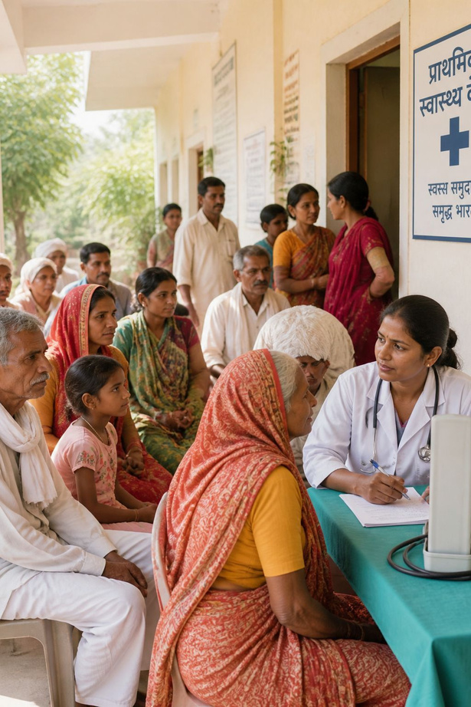
Why AI in Healthcare
77%
Lack Access
of India's population lacks basic healthcare access
1B+
Underserved
people struggle to understand medical reports
24/7
AI Availability
AI can make healthcare accessible and affordable for all
Elderly and illiterate users face the greatest barriers — AI technology bridges this critical gap in healthcare accessibility.

Slide 3
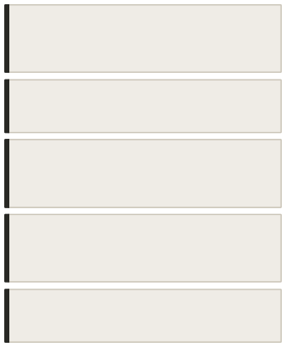
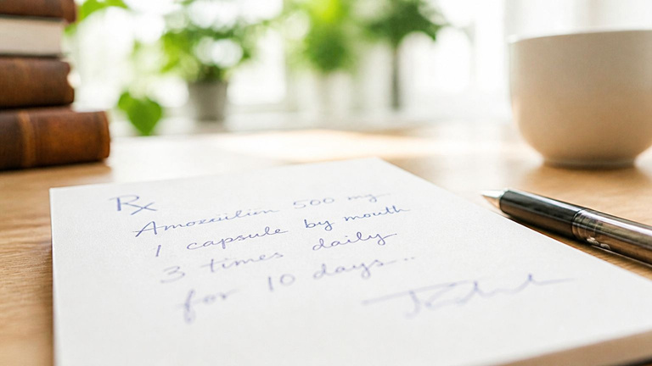
Complex Medical Language
Patients cannot understand medical terminology in
reports
Problem Statement
Doctor's Handwriting
Prescriptions are difficult to read and interpret
Illiterate Users
Cannot read written instructions or follow-up guidance
Elderly Population
Uncomfortable using technology for health
management
Time Constraint
No time to ask follow-up questions to busy doctors

Slide 4
Proposed Solution
Simple Language
Converts complex terms into easy-to-understand explanations
AI-Powered Analysis
Automatically analyzes medical reports with precision
Voice Support
Voice input/output for illiterate and elderly users
Instant Results
Real-time report analysis and explanation on demand

Slide 5
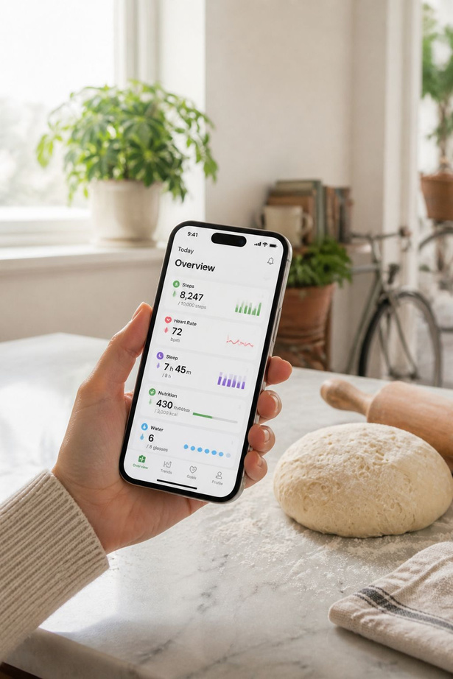

Key Features
📄
Report Upload
Upload prescriptions, blood tests, X-rays, and lab reports
🔍
AI Diagnosis Detection
Automatically identifies conditions and symptoms
💊
Medicine Explanation
Name, dosage, and side effects in simple language
🎤
Voice Message Support
Send queries by voice and receive voice replies

Slide 6
Working Flow Diagram
Upload Report
Patient uploads image or PDF
Data
Voice Option
Extraction
User listens to
Identify condition, medicines,
dosage
results via voice
AI Processing
Result Display
explanation in
OCR and NLP
Showclear
analyze content
simple language
From a simple document upload to a clear, spoken explanation — the entire process is automated, instant, and designed for every type of user.

Slide 7
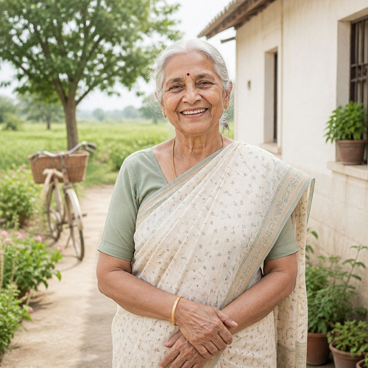
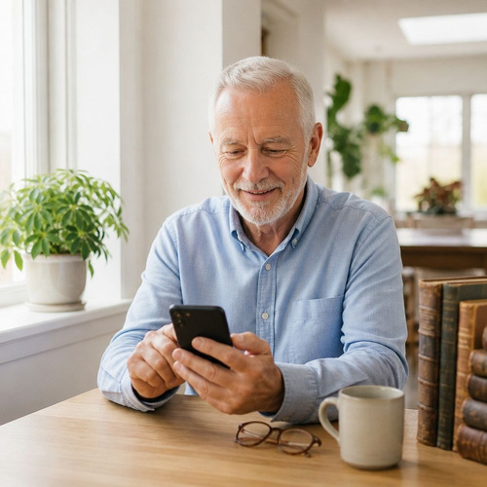


Target Audience
🏘 Rural Population Areas with limited
healthcare access and
infrastructure
👴 Senior Citizens 60+ age group
uncomfortable with
complex technology
󰔡 General Patients People who want to understand their health
information
🏥 Healthcare Workers
Providing basic health guidance in remote
areas

Slide 8
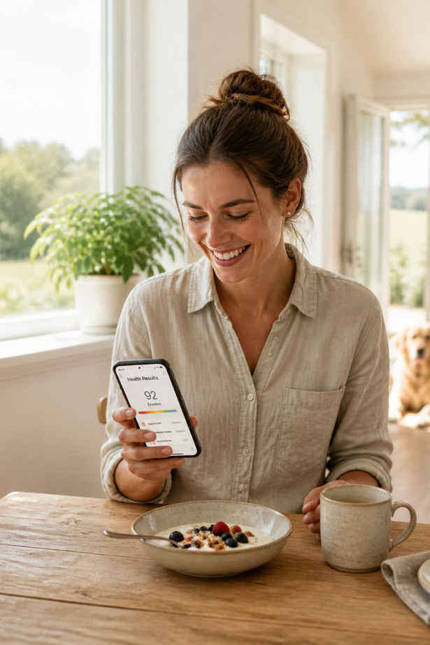
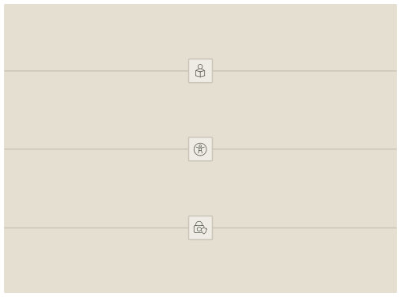
Key Benefits
⏱
Time-Saving
Instant analysis — no waiting for a doctor's appointment
📖
Easy Understanding
Medical terms explained in plain, simple language
♿
Accessibility
Voice feature for illiterate and elderly users
🔒
Privacy & Security
Encrypted, secure patient data storage at all times

Slide 9
Future Enhancements
🌐
Regional languages including Marathi, Tamil, Telugu, and more
🏥
Multi-Language Support
Hospital Integration
Direct access to hospital records and patient history
📊
Health Tracking
󰞯
Doctor Chat Feature
Long-term health records and progress monitoring
Direct consultation with verified doctors in-app
🤖
Advanced AI
📱
Launch on iOS and Android for wider reach
Mobile App Version
Predictive health analysis and preventive recommendations

Slide 10
Implementation Timeline
Phase 1
Months 1–2
Core AI model development and OCR integration
1
2
Phase 2
Months 3–4
Web app development and voice feature integration
Phase 3
Months 5–6
Testing, security audit, and beta launch
3
Phase 4
Month 7+
Full launch,user feedback collection, and continuous
improvements
4
Goal: A fully accessible, AI-powered healthcare assistant live and serving users by Month 7.

Slide 11

THANK YOU !

